Slide 1
Drawing angles
Ms. Latham
Year 7

Slide 2
Learning Intentions
Students will be able to
Practise using the protractor
Draw angles to accuracy of 3 degrees
Read angels with an accuracy of 3 degrees

Slide 3
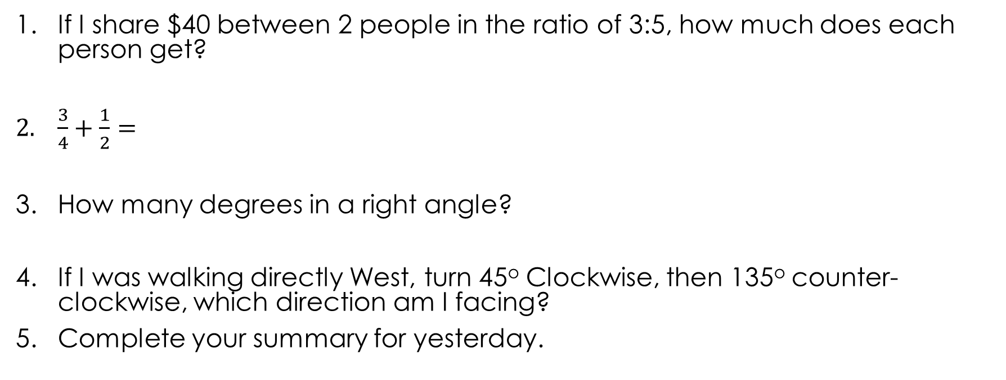
5 Questions
If I share $40 between 2 people in the ratio of 3:5, how much does each person get?
$\frac{3}{4}+\frac{1}{2}=$
How many degrees in a right angle?
If I was walking directly West, turn 45º Clockwise, then 135º counter-clockwise, which direction am I facing?
Complete your summary for yesterday.

Slide 4
https://www.youtube.com/watch?v=hxYIZyC4_v8

Slide 5
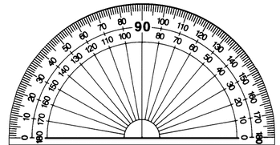
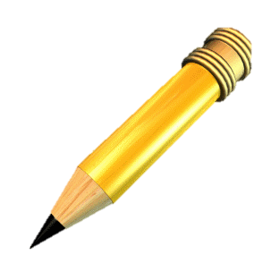
24
7
30
Topic: Drawing Angles
Date:
EQ – How do I draw angles?
How to draw angles?
Step 1: Draw a straight line (you can use a ruler or the bottom of your protractor)

Slide 6
24
7
30
Topic: Drawing Angles
Date:
EQ – How do I draw angles?
How to draw angles?
Step 2: Choose where the vertex will be
A
B

Slide 7
24
7
30
Topic: Drawing Angles
Date:
EQ – How do I draw angles?
How to draw angles?
Step 3: Dot to dot - line up the centre of the protractor with the vertex

Slide 8
24
7
30
Topic: Drawing Angles
Date:
EQ – How do I draw angles?
How to draw angles?
Step 4: Line to line - line up the straight line with the 0°

Slide 9
24
7
30
Topic: Drawing Angles
Date:
EQ – How do I draw angles?
How to draw angles?
Step 5: You read the numbers starting from 0° (where the straight line is) and moving away from 0° until you reach the degree you want and mark with a small dot.
30°

Slide 10
24
7
30
Topic: Drawing Angles
Date:
EQ – How do I draw angles?
How to draw angles?
Step 6: Connect the vertex to the dot
Step 7: Put arrows at the end of the lines
30°

Slide 11

Everyone needs a protractor and a piece of coloured paper.
Send ONE person from each group up to collect the materials.

Slide 12
Guided Practice
Draw these on your left hand side!
Step 1: Draw a straight line
Step 2 : choose where the vertex will be
Step 3: dot to dot
Step 4: line to line
Step 5: Place a dot on the degree
Step 6: Connect the vertex to the dot
Step 7: Put arrows on the end
Notes:
Draw 3-4 angles on the board going through each step.

Slide 13


Partner Paired Practice
Draw two angles on your card
Try to be as accurate as you can be! Help each other
Draw
Pass
Try
Pass the angles to your partner to solve
Complete your summaries!
If you finish early! Keep going making harder and harder ones!
Notes:
Have students glue the cards into their books.

